Slide 1
Introduction to Accounting and Finance Analytics
Acctg & Fin | BUS AN 500 | Class 01
Spring Qtr | 2026

Slide 2

What will we do today?
Course Overview
Introduction to Accounting & Finance Analytics
Define the scope of the Accounting & Finance Function
Analyze Transaction Level Data
Analyze Public Disclosures
Provide a Solution to Disclosure Decision

Slide 3
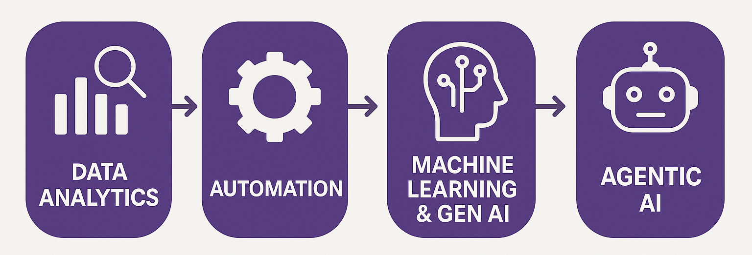
Course Diagram

Slide 4
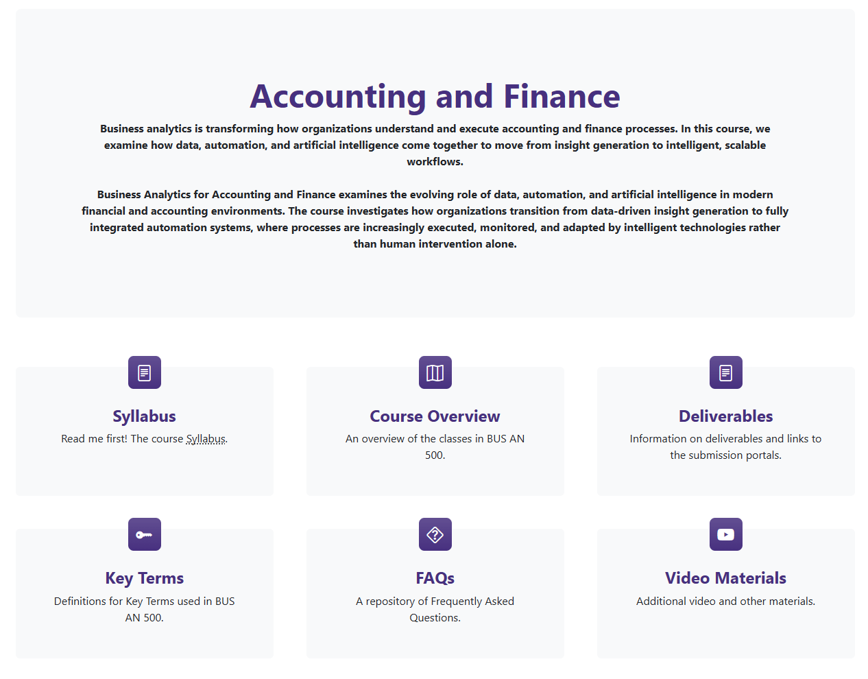
Course Overview

Slide 5
What will we do today?
Course Overview
Introduction to Accounting & Finance Analytics
Define the scope of the Accounting & Finance Function
Analyze Transaction Level Data
Analyze Public Disclosures
Provide a Solution to Disclosure Decision

Slide 6
Accounting & Finance Function
CFO
Controller (CAO)
Treasurer
Director FP&A
Director IA
Director GRC
Financial Reporting
Accounting
Payroll
External payments
Cash Mngt.
Investment
Corporate Finance
Debt Mngt.
Financial Planning and Analysis
Internal Audit
Governance Risk and Compliance

Slide 7
A now Public Company Example (pre-IPO)
CFO
International Finance
NA Finance
Approx 120 employees

Slide 8
That same public company after IPO
CFO
VP Commercial Finance
Tax / Treasury
CAO
Investor Relations / Corp FP&A
CFO EMEA
CFO APAC
CFO LATAM
Strategic Sourcing
Global
Controller
NA Commercial Finance
Finance
Technology
Marketing Finance
Approx 450 employees

Slide 9
Accounting & Finance Function
External Users
Owners and other stakeholders
Banks
Internal Users
Users within a Company
Board of Directors
Managers
Employees
Investors
Shareholders
External Auditor
Creditors
Tax Agencies
Media
Students
Governments

Slide 10
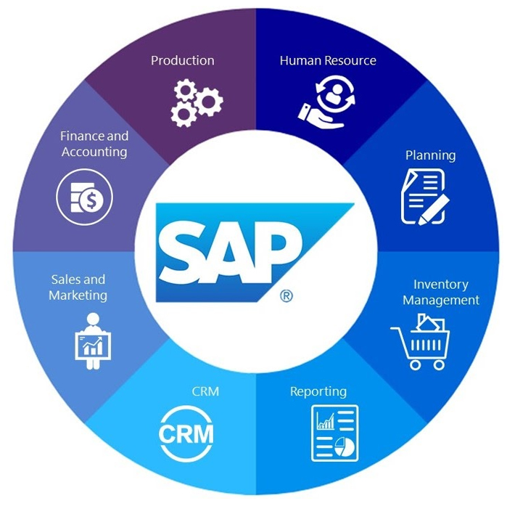
Accounting & Finance Function
Data source for:
Financial Reporting
Accounting Systems
FP&A
Inventory management
Supply Chain Mngt.
And many more

Slide 11
What will we do today?
Course Overview
Introduction to Accounting & Finance Analytics
Define the scope of the Accounting & Finance Function
Analyze Transaction Level Data
Analyze Public Disclosures
Provide a Solution to Disclosure Decision

Slide 12
Transaction analysis
Transactions are events that affect the operations or finances of an organization.
Accounting systems record transactions using a double-entry system using debits and credits.
Transactions are recorded using the accounting equation:
Assets = Liability + Equity
For example, increases to assets are debit entries, liabilities and equites increase with a credit entry.

Slide 13
Transaction analysis, high-level insight
Transactions record the economic activities of the firm so that firms can report meaningful economic aggregates measuring (for example):
Performance over a period: Net Income, Revenue, Cost of Sales (margins), R&D & Salary Expenses, Interest & Tax Expenses.
What they have versus what they owe: Cash, Inventory, What they owe (payables, debt), What they are owed (receivables, prepaid services).
Net Cash generated from their activities: Cash paid, Operating Cash Flows, Investing and Financing cash-flows.

Slide 14
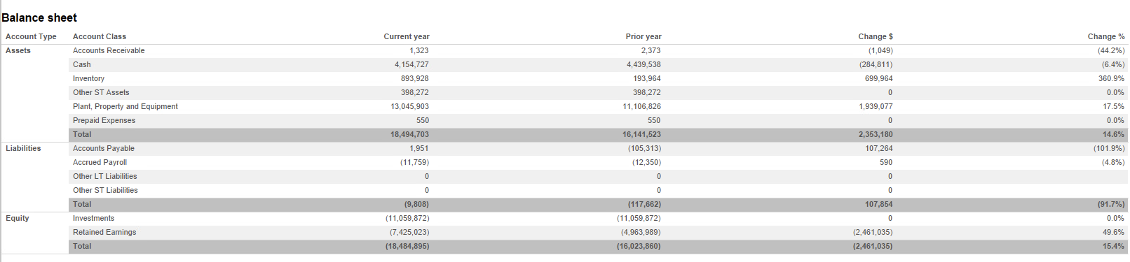
Transaction analysis, balance sheet
 | Assets |  | Liabilities |  | Equity
 | DR | CR | DR | CR | DR | CR

Slide 15
Transaction analysis, income statement
 | Assets > |  | Liabilities = |  | Equity
 | DR |  |  |  |  | CR
 |  |  |  |  | Expenses < | Revenues
 |  |  |  |  | Net Profit
 | Assets < |  | Liabilities = |  | Equity
 |  |  |  | CR | DR
 |  |  |  |  | Expenses > | Revenues
 |  |  |  |  | Net Loss

Slide 16
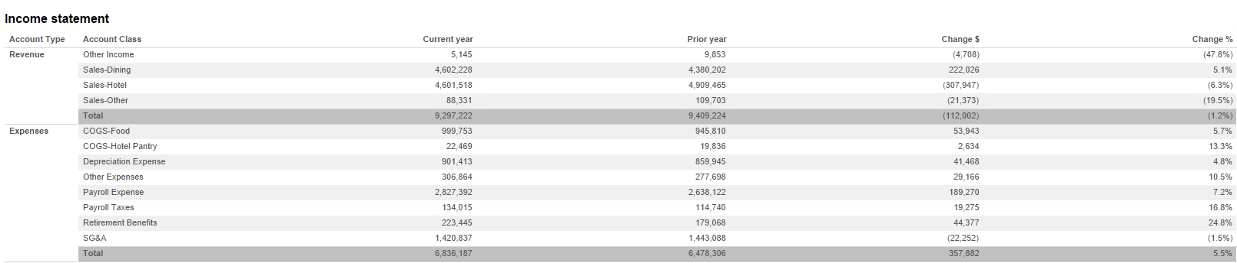
Transaction analysis, income statement
Net Income = Revenues – Expenses
Revenues – Expenses = Net Income
9,297,222 – 6,836,187
= 2,461,035
(a.k.a. a net profit)

Slide 17
Margins
Margins measure the efficiency of turning revenue into income:
Net Profit margin = Net Income / Revenue * 100
Operating Profit Margin = Operating Profit / Revenue * 100
Gross Margin = (Revenue - Cost of Sales) / Revenue * 100

Slide 18
Peach State University, Goal of the Activity
We will use the Peach State University Hotel Cases selectively to:
View typical transaction data
Understand how accounting amounts reflect the economics of the firm
Consider how you would advise company to report their performance (after we analyze public disclosures)

Slide 19
Peach State University, set-up
We undertake an analysis of Peach State University Hotel (a real hotel’s transactions with the name changed).
Three-part case with template (download the template from canvas).
Data analytics tool: Tableau
Set-up in FSB remote labs using https://fprod-hcs.foster.uw.edu/
In the u-drive use cmd to
git clone https://github.com/ashercurtis/datasets.io

Slide 20
Peach State University, background docs
Part 1. Familiarity with the tool. Reference: Analytics_mindset_case_studies_PSU_Hotel_understanding_audit_analytics
Part 2: Understanding sources of revenue. Reference: Analytics_mindset_case_studies_PSU_Hotel_Revenue
Part 3: You will act as an advisor to identify events / transactions / transaction categories to craft the firm’s non-GAAP earnings number. Reference:
Analytics_mindset_case_studies_PSU_Hotel_background (hint: search for events)

Slide 21
What will we do today?
Course Overview
Introduction to Accounting & Finance Analytics
Define the scope of the Accounting & Finance Function
Analyze Transaction Level Data
Analyze Public Disclosures
Provide a Solution to Disclosure Decision

Slide 22
Analyzing Public Disclosures: Market Response to Earnings
+ Earnings news
Key Take Away:
Accounting Income and market prices are positively associated (on average).
Source: Ball and Brown, Journal of Accounting Research, 1968
+ Market return
- Earnings news
- Market return

Slide 23
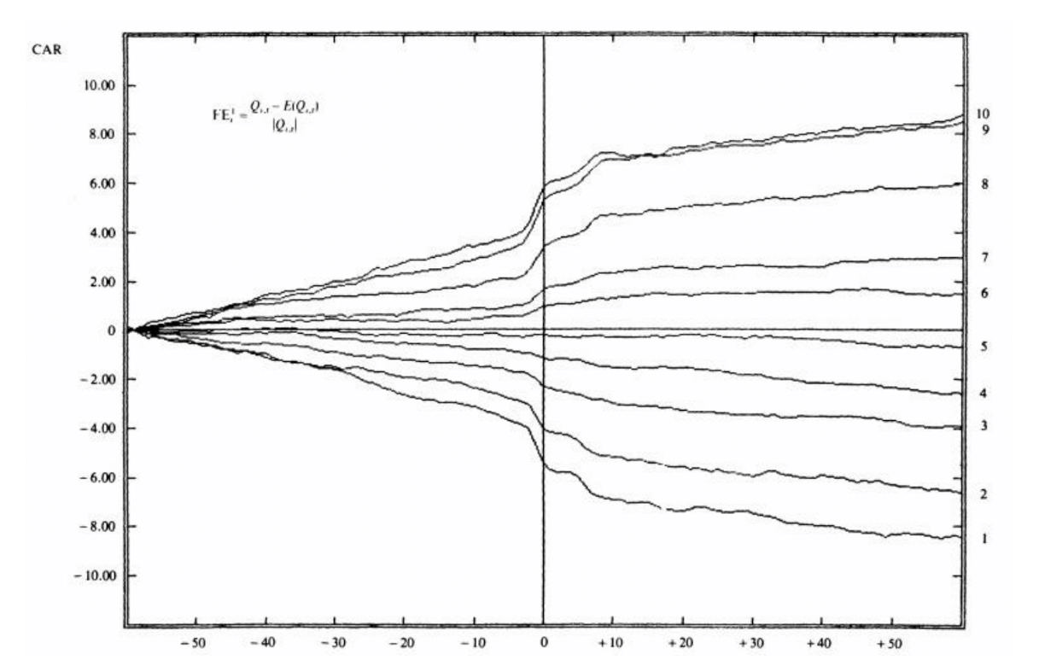
Market responsiveness to earnings news
Markets react to the news in accounting information as well as anticipate it.

Slide 24
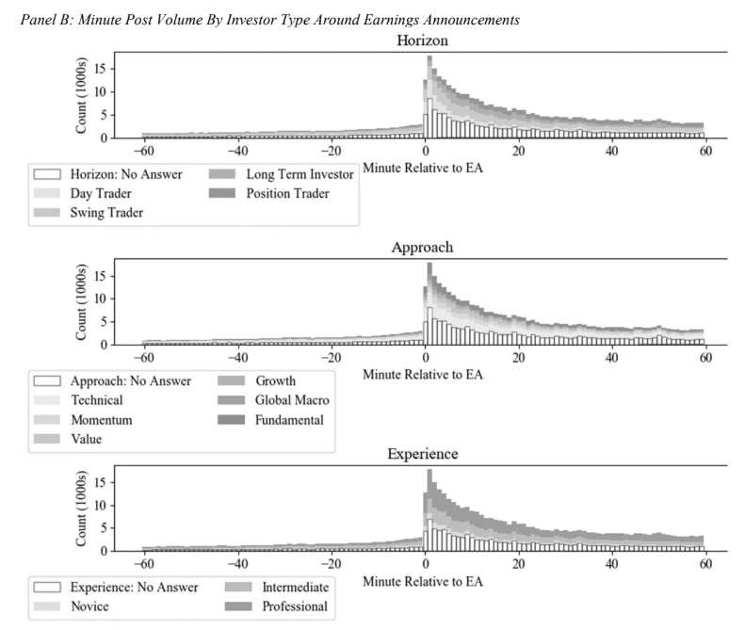
Market responses: Attention
On social media, investors of all types respond and discuss/post about firms more on earnings announcement days.
Source: Booker, Curtis, Richardson, The Accounting Review 2023.

Slide 25
Revision: What is accounting income?
Net Income = Revenues – Expenses
For an accounting period (often reported quarterly, and annually)

Slide 26
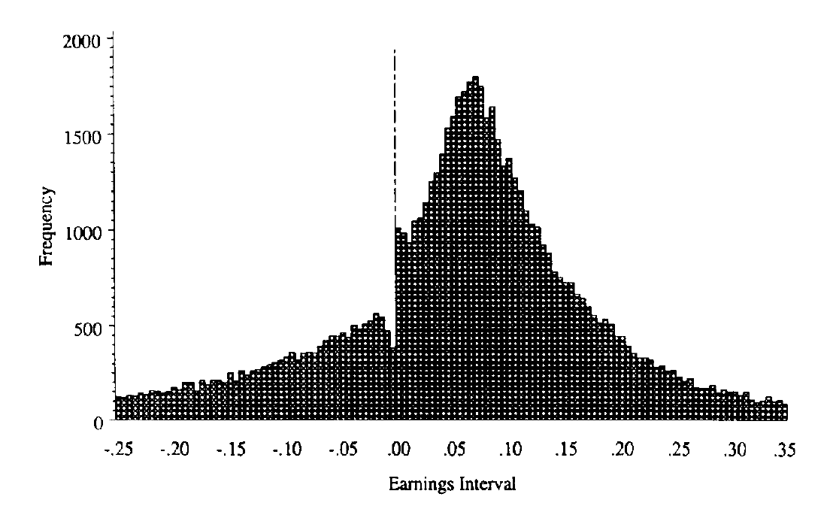
Earnings Distributions
Source: Burgstahler and Dichev, 1997 J. of Accounting & Economics

Slide 27
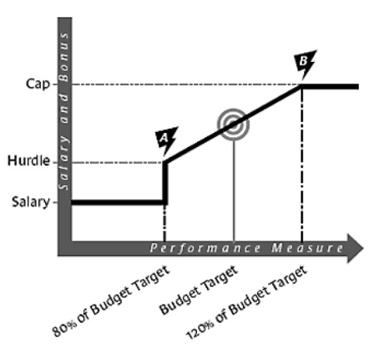
Earnings and Compensation
“Pay for performance”
When compensation is tied to a performance measure, hurdle rates and caps can influence behavior.
Very significant increase for minor performance metric improvement
Versus:
No pay increase regardless of extra performance

Slide 28
The Income Statement, revision
Displays financial performance derived from business operations over a specific accounting period by reporting:
Revenue: inflows of economic benefits that increase shareholders equity.
e.g., sales revenue, service revenue, fees earned
Expenses: Use or loss of economic benefits that decrease shareholders equity.
Incurred when you use resources to generate revenue, e.g., cost of goods sold, wages and salaries
If revenues are greater than expenses, a net profit is reported
If revenues are less than expenses, a net loss is reported

Slide 29
Understanding the Income statement
Core operating:
Sales, COGS, SG&A, Depreciation
Most likely to recur
Core Non-operating:
Interest, minority interests
Non-operating income, income tax
Non-core events/items:
-restructuring charges
-write-offs
-M&A costs
Discontinued operations, extraordinary items
Least likely to recur

Slide 30
GAAP and Non-GAAP
GAAP EPS
Pro-forma / Non-GAAP EPS
Measured according to well established rules (GAAP)
Often comparable across firms
Includes transitory items, discontinued operations and extraordinary items
Based on managers discretion
Not often comparable across firms
Highlighted by the SEC as a potential fraud risk
Measures core earnings, / the firm’s own measure of performance
Often used in CEO compensation

Slide 31
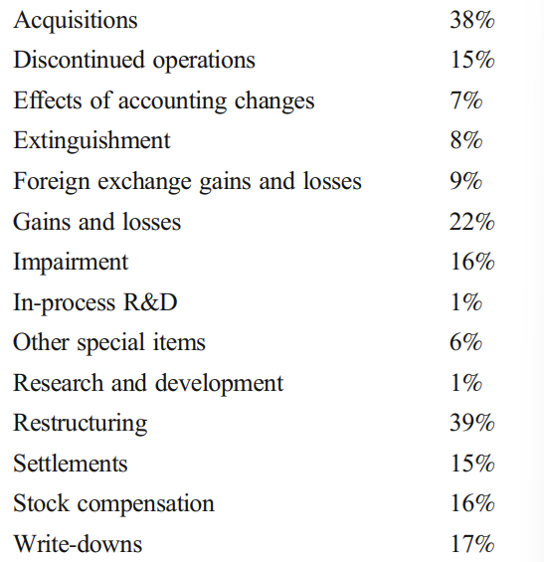
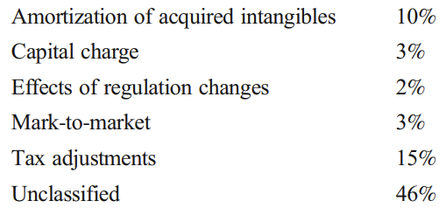
Frequency of Items Excluded from compensation targets
Source: “The Use of Adjusted Earnings in Performance Contracts” Curtis, A., Li, V., and Patrick, P., (2021). Review of Accounting Studies, Vol. 26, pp. 1290–1322.

Slide 32
Analyzing Public Disclosures, Activity
Group Activity:
Part 1: Analysis of Marriott’s Public Disclosures (as a class).
Investor Relations | Marriott International
Part 2: Analysis of other company filings (in small groups)

Slide 33
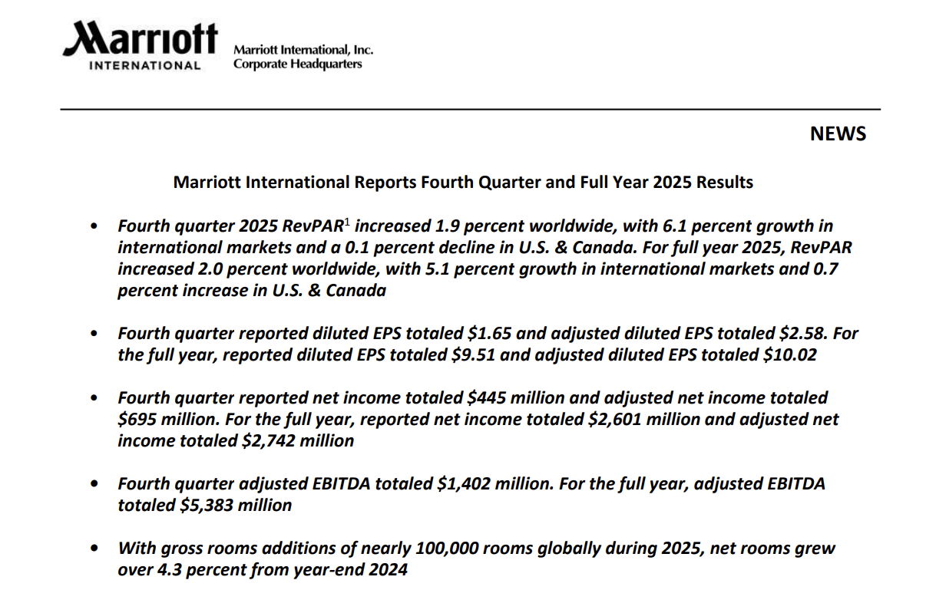
Marriott Earnings Report
4. Earnings Before Interest, Tax, Depreciation and Amortization: EBITDA (GAAP), adjusted EBITDA (Non-GAAP)
1. RevPAR: Revenue Per Available Room (Non-GAAP), Key Performance Indicator (KPI)
2. Reported EPS (GAAP), adjusted EPS (Non-GAAP)
3. Reported Net Income (GAAP), adjusted Net income (Non-GAAP)
5. Gross Room Additions (non-financial performance measure).

Slide 34
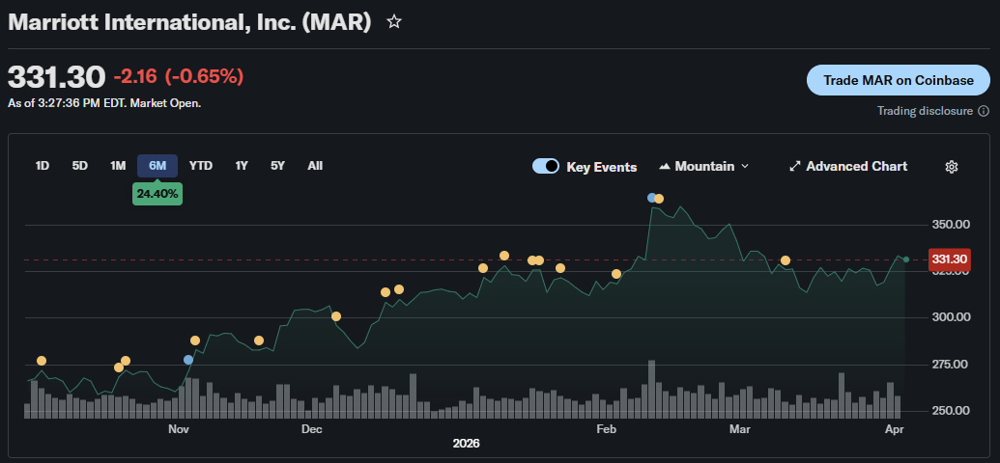
Marriott

Slide 35
Analyzing Public Disclosures
Team Activity:
Part 2: Analysis of other company filings (in teams)
Hilton – Investor Relations
Hyatt Hotels Corporation - Investor Relations
Investors - InterContinental Hotels Group PLC
Wyndham Hotels & Resorts, Inc. (WH)

Slide 36
What will we do today?
Course Overview
Introduction to Accounting & Finance Analytics
Define the scope of the Accounting & Finance Function
Analyze Public Disclosures
Analyze Transaction Level Data
Provide a Solution to Disclosure Decision

Slide 37
What will we do next?
The Accounting & Finance Function with Self-Service Analytics using Alteryx
Explore some Compliance and Accounting & Finance Data Analytics from a production side.
Use a self-service analytics tool (Alteryx) to produce working repeatable analytic end-to-end workflows for specific tasks.

Slide 38
Thank you

